Slide 1
Operation Analytics and Metric Spike
By NELLURI ARAVIND

Slide 2
Description
Operational Analysis is useful for complete end to end operations of data and to further predict the overall growth or decline of data, which is helpful in providing the areas for improvement in the current/given system/data.
Along with Operational Analysis investigating metric spikes is also essential as it helps in predicting the reasons and conditions for the behaviour(growth/decline) of data.
In this project we were provided with different data sets table from which we must bring out certain insights and answer all the questions asked by different departments.

Slide 3
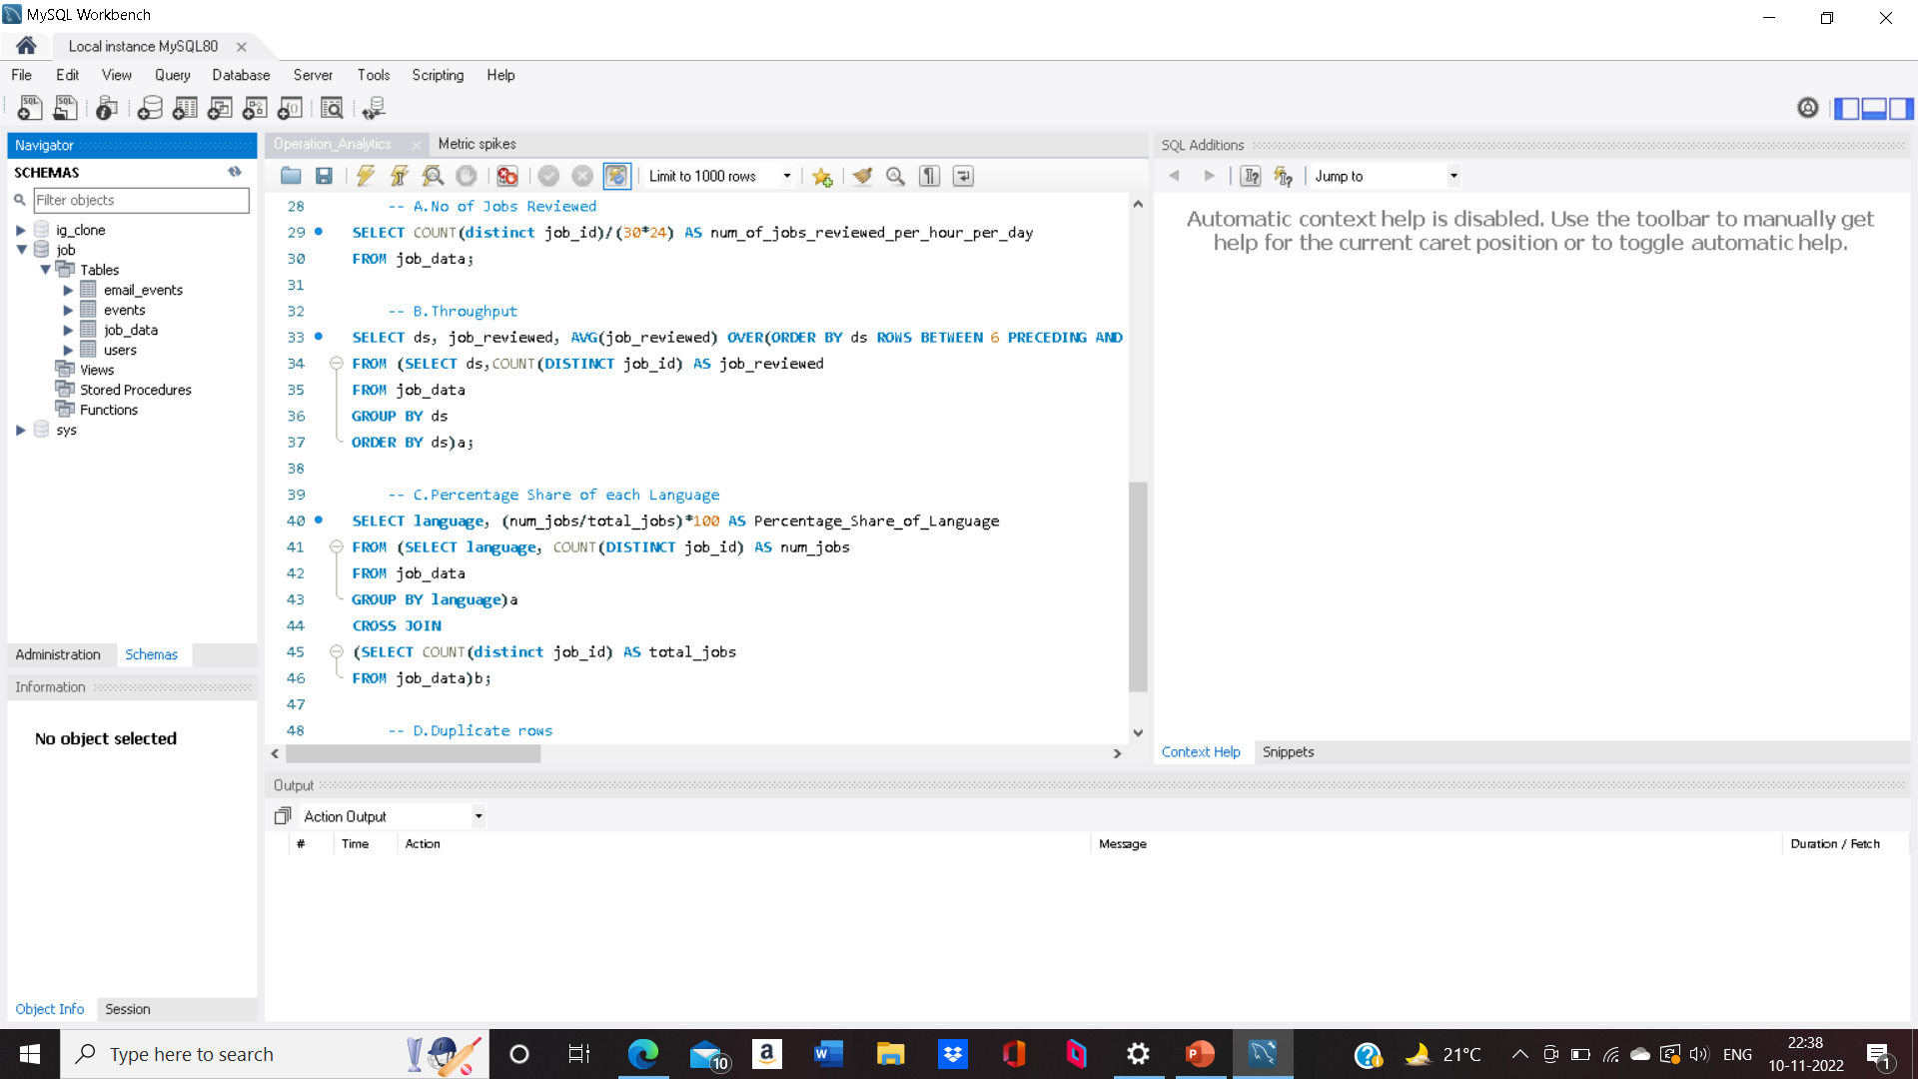
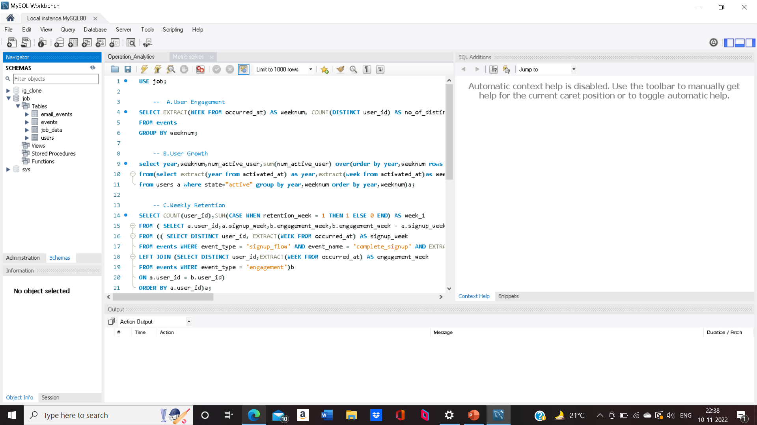
Approach
The first thing to complete this project is to import the data from excel to your preferred editor(MySQL workbench/ Mode) for MySQL Workbench this could be done in two ways i.e: By Writing Query or By using create new schema tab.
After the above step the second crucial step is to ask/evaluate appropriate questions which will make it easier to access and retrieve data using SQL Querries.
Approach carried is shown in below images. The complete detailed approach could be seen in the file attached with the presentation Operational Analysis Metric Spikes

Slide 4
Tech-Stack
MS PowerPoint - Documentation
MS Excel - For Getting Logic
MySQL Workbench - For Loading Database and Writing Query
Mode.com - For Checking answers

Slide 5
Insights
32nd week of 2020 doesn’t seem good for platform as significant number of users disengaged.
The overall growth of platform is good since number of users keep increasing.
Mostly used laptop is MacBook pro.
Mostly used mobile is iPhone 5.

Slide 6
Result and Drive link
This project helps in understanding the use of windows function and also helpful in learning to draw insights from the data.
Drive Link for this project is : https://drive.google.com/drive/folders/1Q3E1ZkRZUy_jcVKd_fNnzZ5ogwp5j2F5?usp=share_link

